Slide 1
DLIP Final Project
Implementation of emergency braking system for autonomous vehicles
using deep learning and sensor calibration
2023. 6. 16
Handong Global University
21800774 Min-Woong Han
21800805 Seung-Eun Hwang
Advisor : prof. Young-Keun Kim
Notes:
Hello everyone. I’m here to present our DLIP final project.
Our topic is ‘implementation of emergency braking system for autonomous vehicles using deep learning and sensor calibration’.

Slide 2
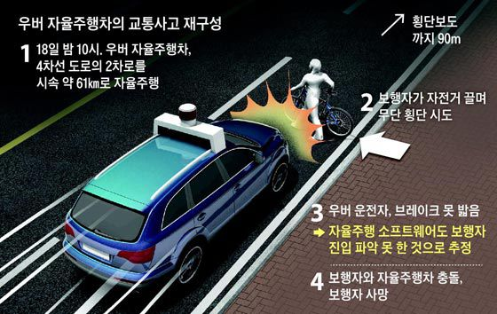
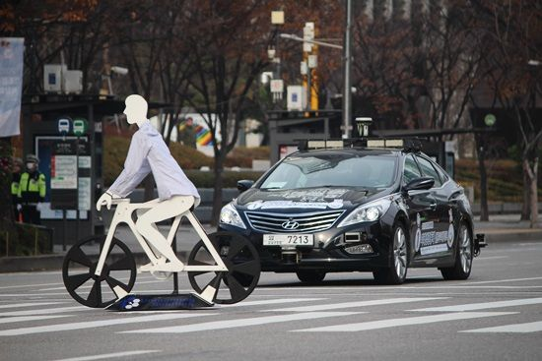
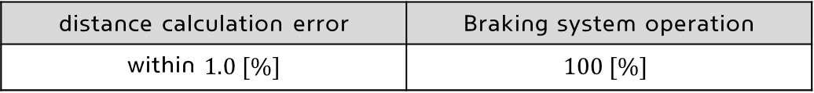
▣ Problem definition
Research background and purpose
○ Pedestrian collision accident of autonomous vehicle
Accurate recognition of pedestrian based on sensor data
Judging objects that do not need to react significantly
Determined no need to avoid it in software
Need high accuracy detection & Distance calculation & Proper judge
[ accident situation ]
○ Proposal of this project
Emergency braking system development
Using deep learning object detection & Sensor calibration
Project goal
distance calculation error | Braking system operation
within $1.0 [\%]$ | $$100 [\%]$$
Notes:
First, the background and research objective for our topic are as follows.
In 2018, there was a tragic accident in the United States during the testing phase of a self-driving car known as Uber.
The accident involved a cyclist illegally crossing the road, and unfortunately, the person was hit by the vehicle and lost life.
This accident raised concerns and amplified the doubts surrounding the safety of autonomous driving systems.
With this problem as the backdrop, the goal of this project is to develop a safe emergency braking system for sudden obstacles.

Slide 3
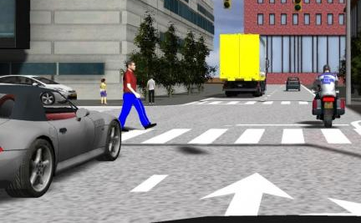
▣ Problem definition
Proposal
To cope with unexpected situation
Proper object detection & Distance calculation is essential
Pedestrian
Object detection | Distance calculation
Sensor : camera | Need other sensor
Deep learning
Impossible to get exact distance with single camera
Sensor calibration problem
Notes:
To address this issue, it is essential to have object detection for suddenly emerging objects and crucial to know the distance to those objects.
Firstly, we utilized a camera sensor for object detection.
However, with a single camera, it is impossible to determine the distance to the objects accurately.
Therefore, it requires available information of another sensor capable of measuring distance.

Slide 4
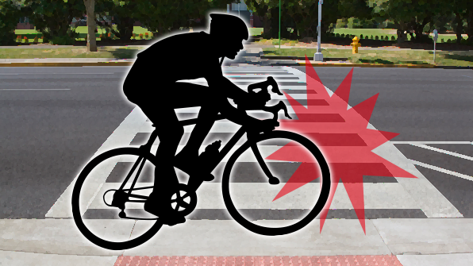
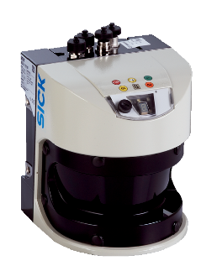
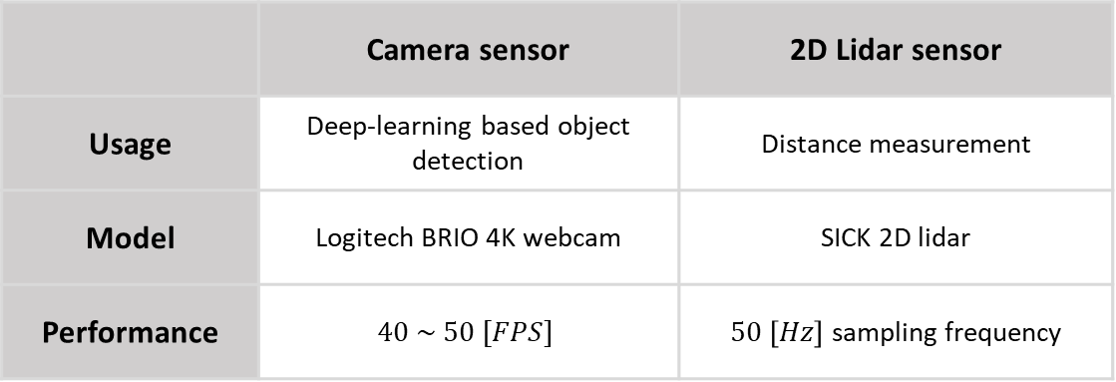
▣ Requirements
Hardware part
 | Camera sensor | 2D Lidar sensor
Usage | Deep-learning based object detection | Distance measurement
Model | Logitech BRIO 4K webcam | SICK 2D lidar
Performance | $$40 \sim 50 [FPS]$$ | $50 \left[Hz\right]$ sampling frequency
* 2D Lidar sensor
TOF system
Measure the time of flight for the laser to reflect off an object and return → Calculate distance
2D : Only one vertical channel
Notes:
To measure the distance of detected object, we used 2D LiDAR sensor.
The 2D LiDAR sensor is based on the Time-of-Flight (TOF) system, which emits lasers and measures the time it takes for them to return, enabling distance measurement of objects.

Slide 5
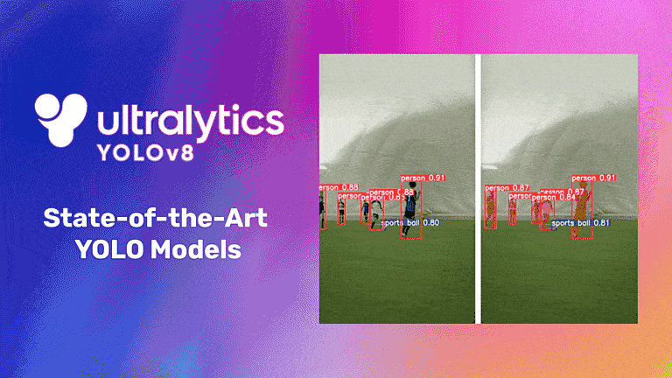
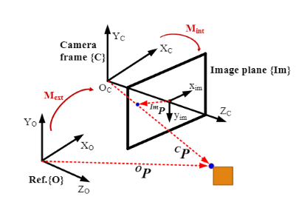
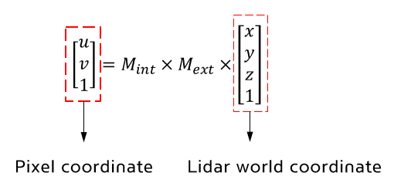
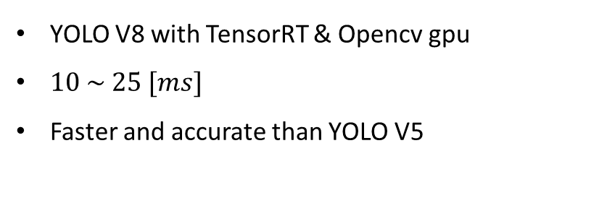
▣ Requirements
Software part
Deep learning part
Image processing part
YOLO V8 with TensorRT & Opencv gpu
$10 \sim 25 [ms]$
Faster and accurate than YOLO V5
Sensor calibration process
Project lidar data to pixel coordinate by calibration
Notes:
Next, I will provide an overview of the software architecture, and flow chart.
In the software part, we used the YOLO V8 deep learning model.
YOLO V8 offers faster and more accurate performance with less training data compared to YOLO V5.
In the image processing part, since we are using two sensors, it is essential to perform sensor calibration to unify the axes of the sensors for the fusion of available information.
We will discuss the details of this calibration process later in the presentation.

Slide 6
▣ System overview
Flow Chart
Data Preparation
& Model training
Sensor calibration
Calibration verification
Obstacle emergency braking system
Dataset
- custom datasets for deep
learning
Object detection
Distance calculation of detected object
Performance verification
Result analysis
Notes:
The overall flow chart is as follows: First, we prepared a custom dataset for rubber cones for training purposes.
We then proceed with model training. The reason for training with rubber cones will be explained later.
After the training, we perform sensor calibration and validate the calibration process.
Following that, we construct a system to handle sudden obstacles.
Finally, we conduct performance evaluation and analyze the results obtained.

Slide 7
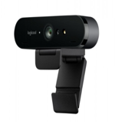
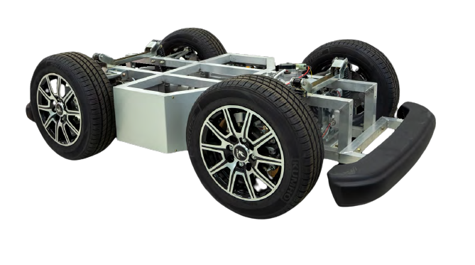
▣ Architecture
Software architecture
Deep learning process
Sensor calibration &
Post processing
Lidar interface process
1
2
3
 | Contents | Communication method
1 | Bounding box center point of detected object | Shared memory
2 | Distance and azimuth
3 | Velocity & Steering | RS232 serial communication
Notes:
The software architecture is as follows: it consists of three main codes running simultaneously, which are the data reception code for LiDAR, the deep learning-based object detection process, and the main code responsible for sensor calibration and post-processing.
Each code communicates through a technique called shared memory, and the shared information exchanged between them is as below.

Slide 8
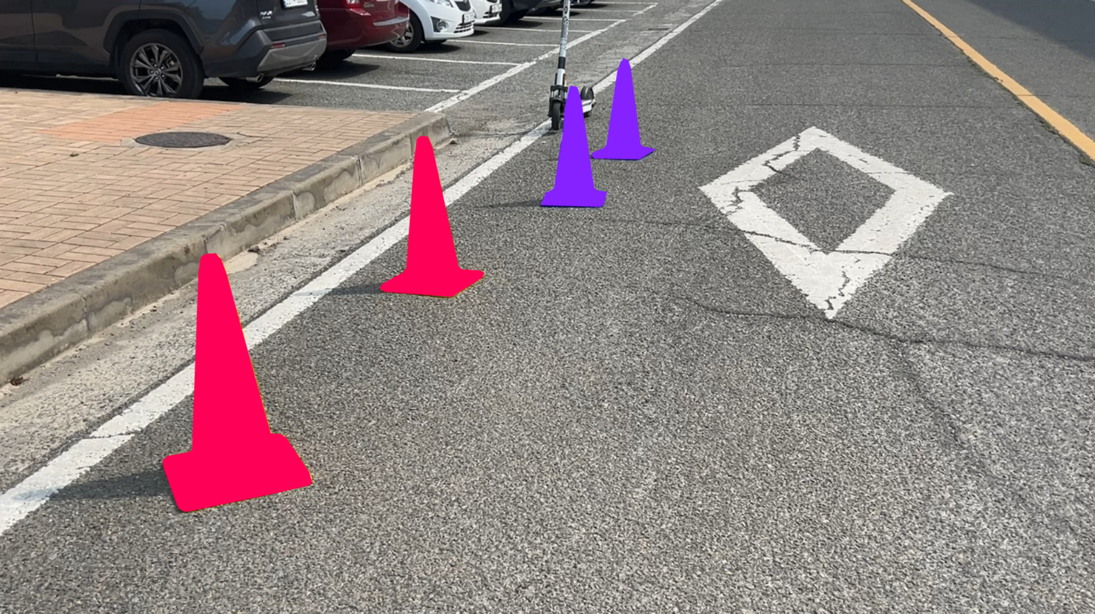
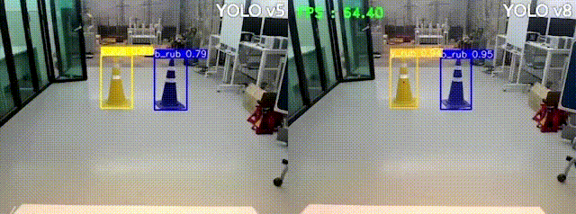
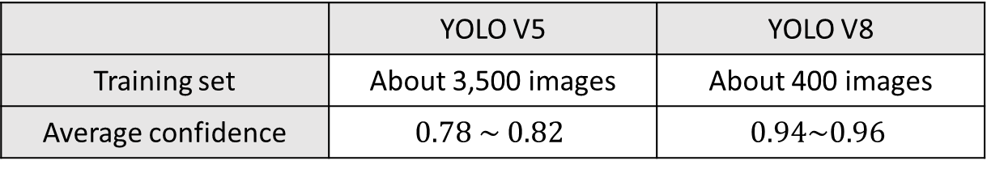
▣ Object detection
YOLO V8 training
Comparison V5 & V8
Yolo V5
Yolo V8
Custom datasets
Segment annotation
Only use 400 images for training
 | YOLO V5 | YOLO V8
Training set | About 3,500 images | About 400 images
Average confidence | $$0.78 \sim 0.82$$ | $$0.94\sim 0.96$$
Used yolo V8 & confidence threshold : $0.9$
Notes:
From now on, I’d like to explain how we trained deep learning model and how we calculated distance.
In the process of training, a total of 400 images were used.
Compared to the V5 model, it was clear that we could achieve high accuracy with fewer numbers of data.
As can be seen in the video, the average confidence value recognized by V8 model is higher than V5 model.
In the experiment, in order to prevent incorrect object detection, the confidence threshold was set to 0.9 and the experiment was conducted.

Slide 9
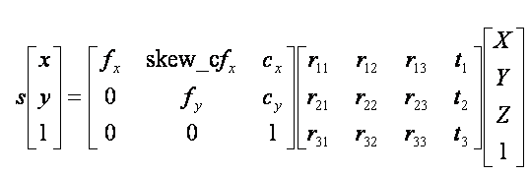
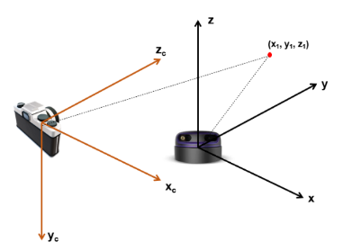
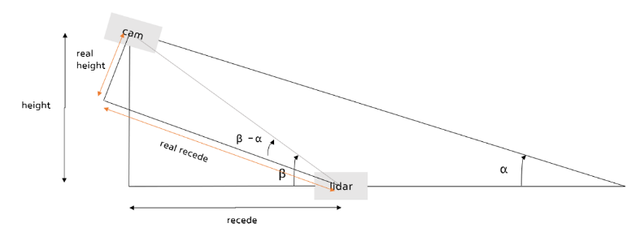
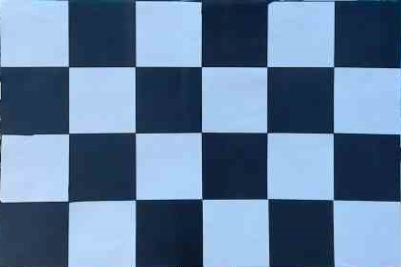
▣ Sensor calibration
Intrinsic matrix
Extrinsic matrix
Calculation of intrinsic matrix
Calculation of extrinsic matrix
Camera internal parameter matrix
Matlab tool with checkerboard was used
Compensation of sensor position and positional difference
Essential matrix for correct calibration
Notes:
The calibration of the two sensors must be conducted to proceed experiment.
Through calibration, the X, Y, and Z coordinates of the LiDAR can be projected onto the camera's pixel coordinates.
The calibration can be carried out using the equation as you can see in this page.
The intrinsic matrix, composed of internal parameters of a camera, was obtained using a checkerboard and a toolbox in MATLAB.
Next, the extrinsic matrix, which corrects the position and orientation differences between the two sensors, needs to be determined.

Slide 10
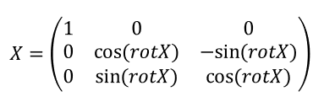
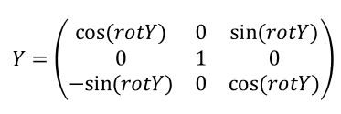
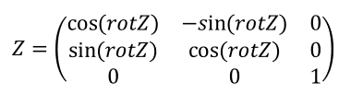
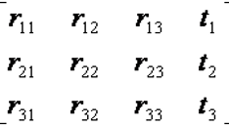
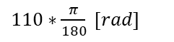
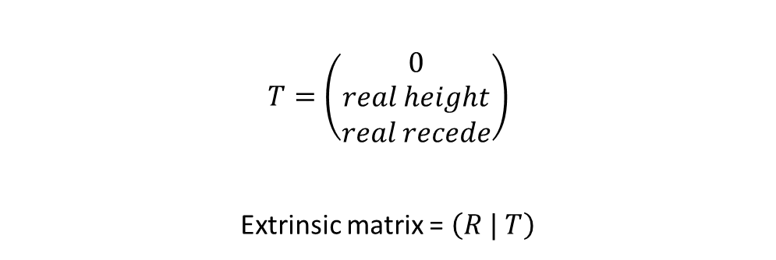

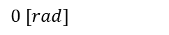
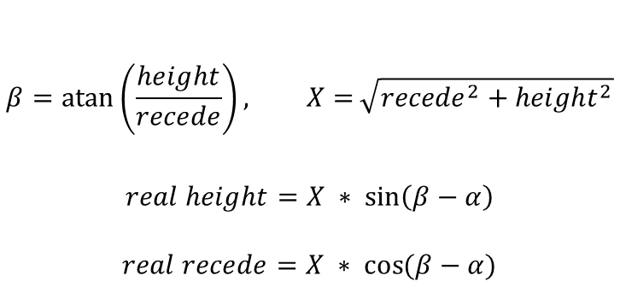
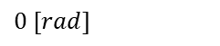
▣ Sensor calibration
Extrinsic matrix (detailed process)
$110∗\frac{π}{180} [rad]$
$0 [rad]$
$0 [rad]$
$$R=Z∗Y∗X$$
$$β=\operatorname{atan}\left(\frac{height}{recede}\right), X=\sqrt{{recede}^{2}+{height}^{2}}$$
$$real height=X ∗ \sin\left(β−α\right)$$
$$real recede=X ∗ \cos{(β−α)}$$
R matrix
$$T=\left(\begin{matrix}0 \\ real height \\ real recede\end{matrix}\right)$$
Extrinsic matrix = $\left(R | T\right)$
Notes:
The detailed process of calculating extrinsic matrix is as follows. Due to time constraints, I will skip the detailed explanation for this page.

Slide 11
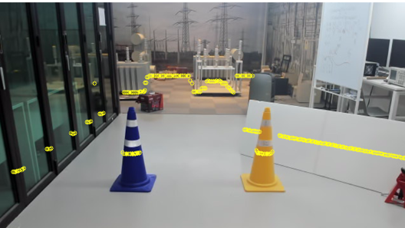
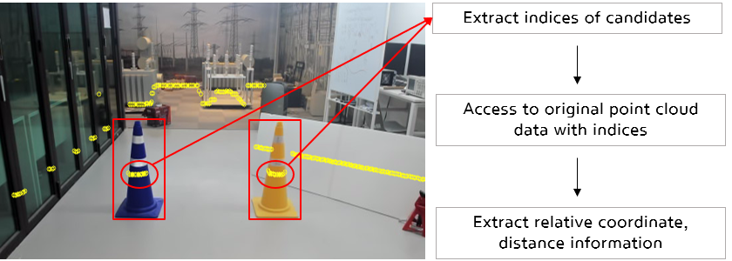
▣ Sensor calibration
Calibration result
: Lidar data can be projected to pixel coordinate
Camera image
Yellow points : lidar points projected on to pixel coordinate
Extract indices those are on rubber cones
Access to original point cloud data with indices
Calculate relative coordinate & distance information based on lidar sensor
Notes:
The results of the calibration are as follows. On the left is the camera image, and the yellow points overlaid on it represent the actual LiDAR point cloud data projected onto pixel coordinates.

Slide 12
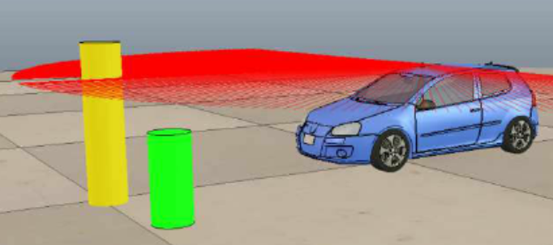
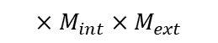

▣ Distance calculation
Procedure
Sensor calibration & Model training finished
How to get distance & relative coordinate of detected object?
Step 1
Step 2
Step 3
Access to original data with index
Original data has$x,y$information
Can get useful information
$$×M_{int}×M_{ext}$$
Distance of object
Azimuth angle of object
Projection on pixel points
Extract index of points those
are on rubbercone
Each point has ‘index’
Notes:
Exactly, the points projected onto pixel coordinates are essentially the original point cloud data, and they each have their corresponding indices.
Therefore, by extracting the indices of the pixel points that exist on the rubber cone, we can access the original point cloud data and easily obtain the distance and azimuth angle information for that particular rubber cone.

Slide 13
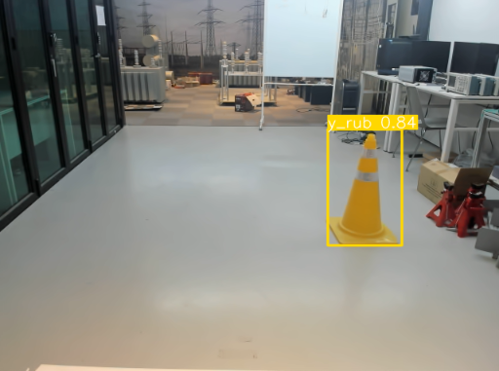
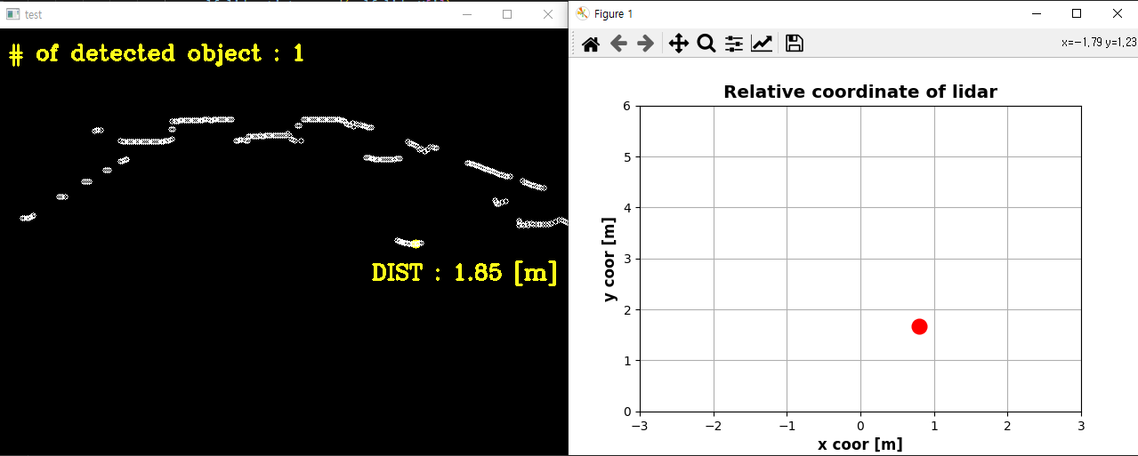
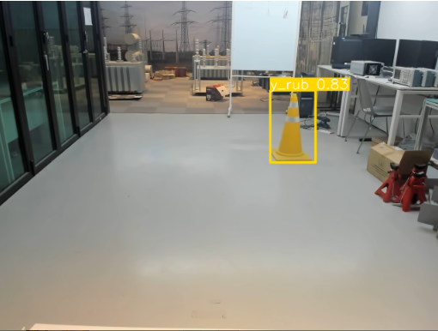
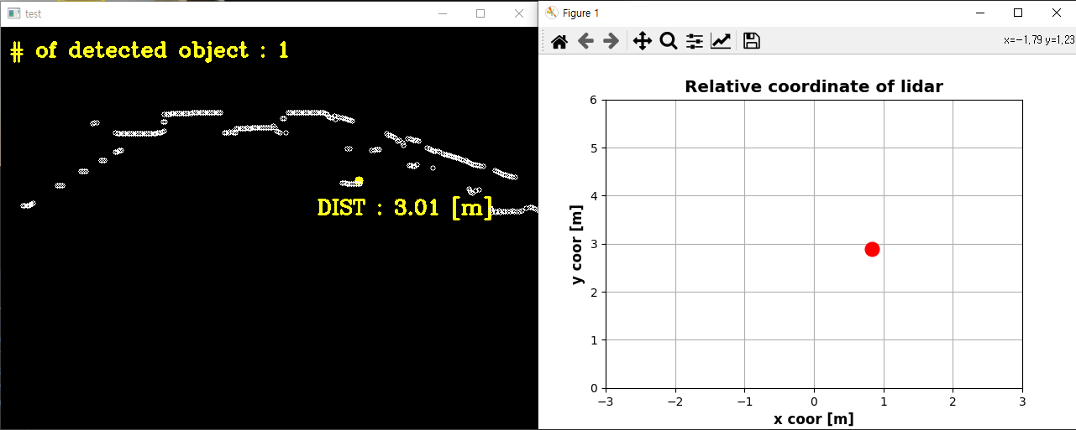
▣ Fusion result
Distance measurement
Case 1
Case 2
Notes:
From case 1 to case 4, the position of a single rubber cone was moved, and the corresponding distance and coordinates were calculated.
When observed sequentially, it can be confirmed that the distance values and coordinates for each case were successfully extracted.

Slide 14
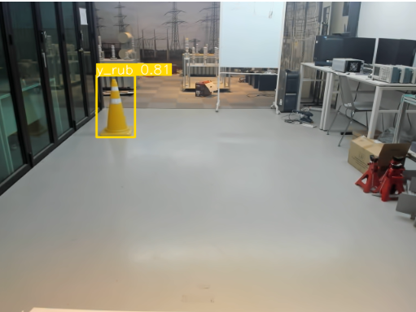
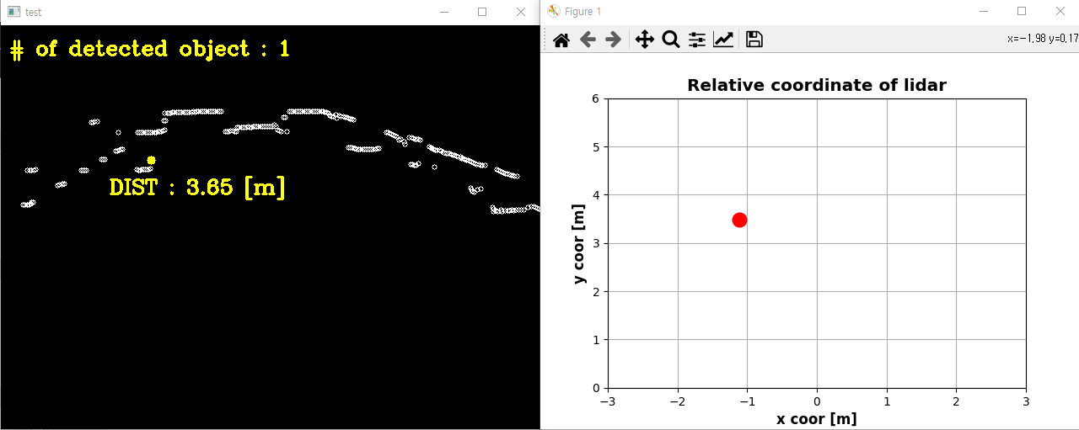
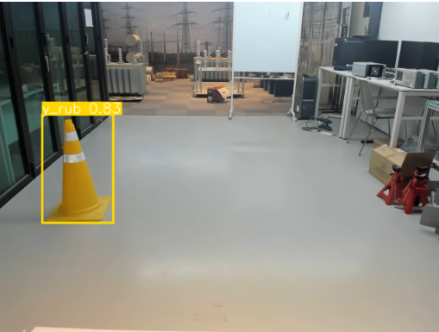
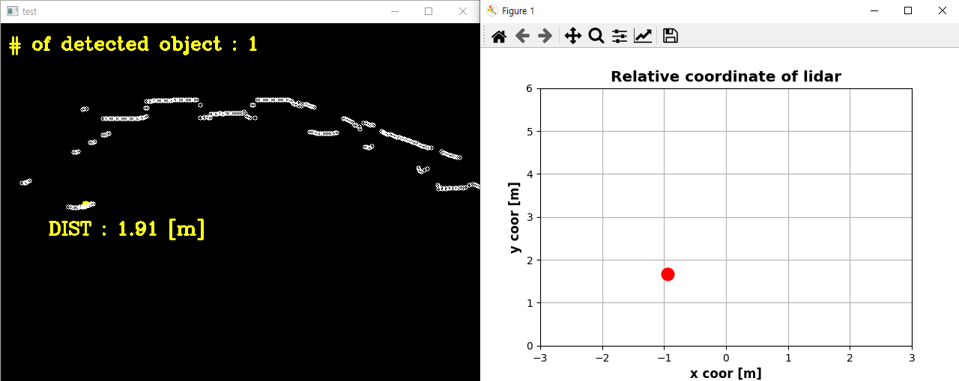
▣ Fusion result
Distance measurement
Case 3
Case 4
Notes:
Case 3 and 4 is introduced in this page.

Slide 15
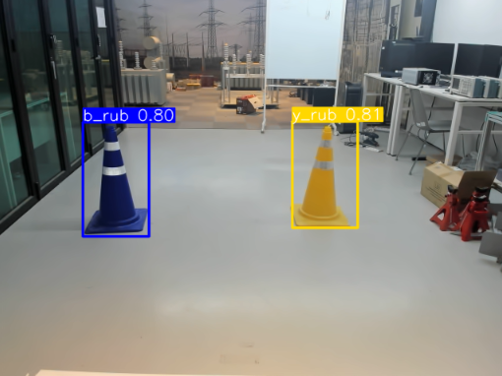
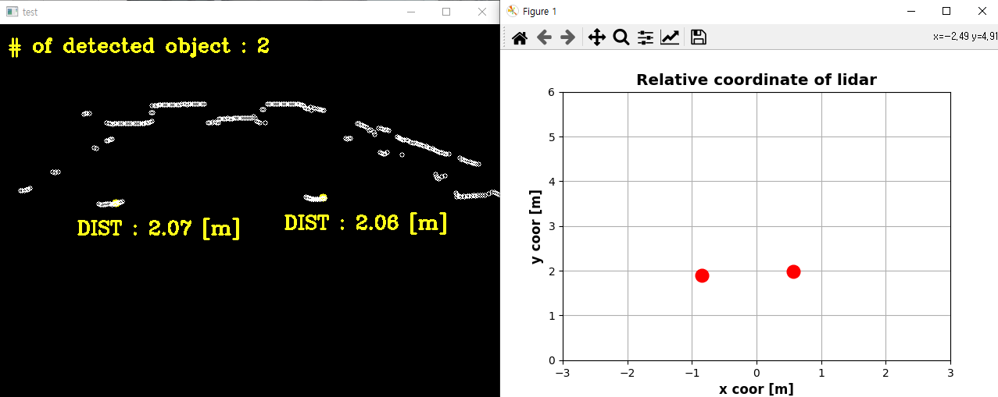
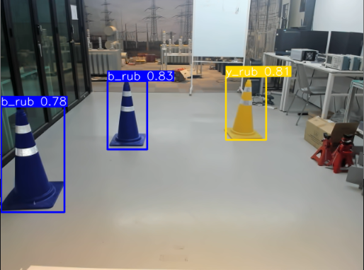
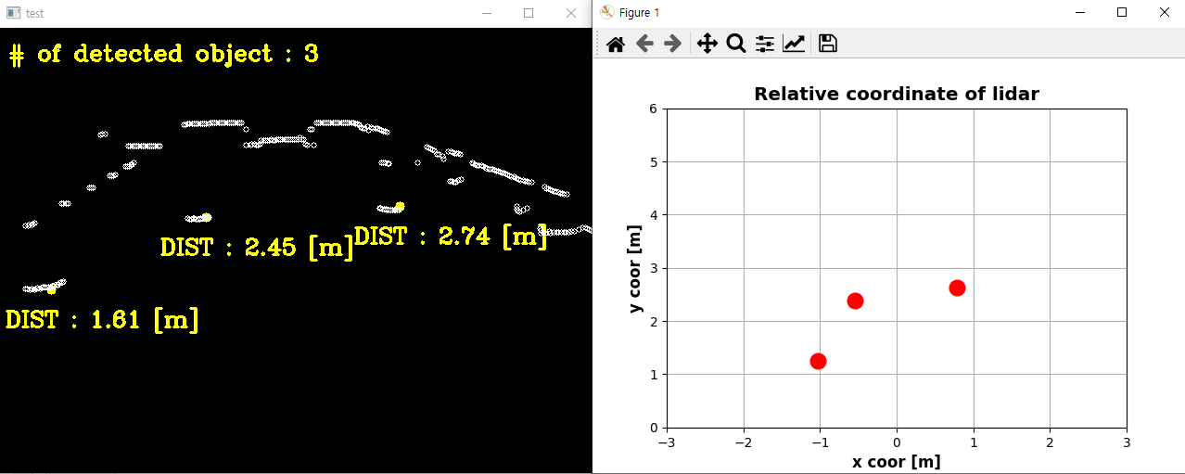
▣ Fusion result
Distance measurement
Case 5
Case 6
Notes:
In case 5 and 6, even with multiple rubber cones present, it can be observed that the distances and relative coordinates for each cone are accurately calculated without any issues.
This means that simultaneous distance measurements for multiple objects can be achieved successfully.

Slide 16
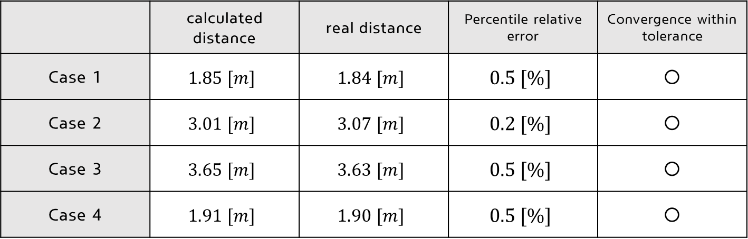
▣ Calibration result analysis
Calibration performance evaluation
 | calculated distance | real distance | Percentile relative error | Convergence within tolerance
Case 1 | $$1.85 [m]$$ | $$1.84 [m]$$ | $$0.5 [\%]$$ | ○
Case 2 | $$3.01 [m]$$ | $$3.07 [m]$$ | $$0.2 [\%]$$ | ○
Case 3 | $$3.65 [m]$$ | $$3.63 [m]$$ | $$0.5 [\%]$$ | ○
Case 4 | $$1.91 [m]$$ | $$1.90 [m]$$ | $$0.5 [\%]$$ | ○
Set error range : within $1.0 \left[\%\right]$
Notes:
This evaluation represents the accuracy of distance measurement through calibration.
Cases 1 to 4 all exhibit percentile relative errors within 1%. It can be confirmed that all values come within the target range : 1% error.

Slide 17
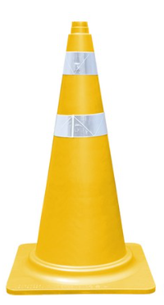
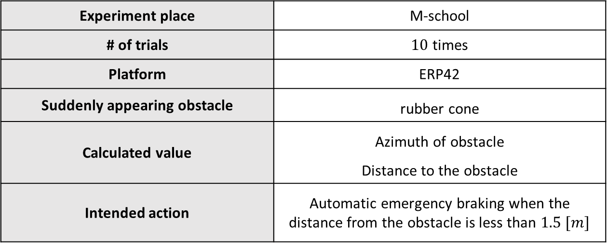
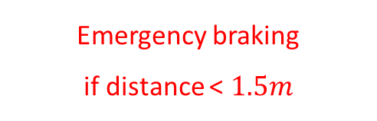
▣ Experiment
Emergency braking system
Experiment place | M-school
# of trials | $10$ times
Platform | ERP42
Suddenly appearing obstacle | rubber cone
Calculated value | Azimuth of obstacle Distance to the obstacle
Intended action | Automatic emergency braking when the distance from the obstacle is less than $1.5 [m]$
Emergency braking
if distance < $1.5m$
Notes:
Calibration was confirmed and verified to be accurate, and an emergency braking system experiment was conducted.
The experiment took place in Newton Hall underground, and a total of 10 trials were conducted.
To ensure safety, rubber cones were used instead of humans during the experiment.
This is the reason why we trained rubbercone instead of human.
And real-time calculations of the azimuth angle and distance of detected obstacles were performed, and emergency braking was initiated when the distance was less than 1.5 meters.

Slide 18


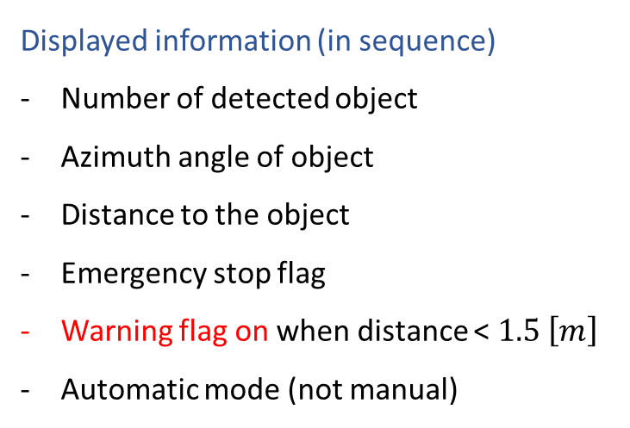
▣ Experiment
Result (Demo video)
Displayed information (in sequence)
Number of detected object
Azimuth angle of object
Distance to the object
Emergency stop flag
Warning flag on when distance < $1.5 \left[m\right]$
Automatic mode (not manual)
Substituted !
Notes:
Let’s watch demo video here. This is the experiment result. We can know the distance and position of the suddenly appearing obstacles through this algorithm.

Slide 19



▣ Conclusion
Result analysis
Discussion & Analysis
[ Set goals ]
Distance calculation performance : achieved goal range
10 success with 10 trials of experiments : achieved goal range
Developments
Using 3D lidar
Shape-based learning of object is possible (point pillar)
Highly useful when object recognition is difficult at night
# of experiment trials | $$10$$
Braking success | $$10$$
Braking failure | $$0$$
Success rate | $$100 [\%]$$
[ Achieved goals ]
# of experiment trials | $$10$$
Braking success | $$10$$
Braking failure | $$0$$
Success rate | $$100 [\%]$$
Notes:
As previously mentioned, a total of 10 experiments were conducted, and in all 10 trials, the emergency braking system operated successfully.
The set experimental objectives were achieved. With accurate calibration and post processing, successful experiment result could be obtained.
Furthermore, discussing for further improvement, if the experiment is conducted using a 3D LiDAR with the same calibration process, it is expected that more reliable post-processing can be performed by utilizing the shape information of objects.
Additionally, applying 3D point-based learning techniques like PointPillars could enable more accurate post processing.

Slide 20
Thank you
Notes:
Thank you for listening to my presentation.

